Slide 1



COURSE SELECTION NIGHT
ALMETA CRAWFORD HIGH SCHOOL

Slide 2
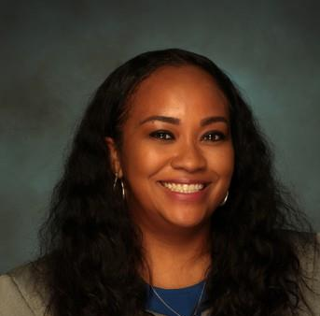
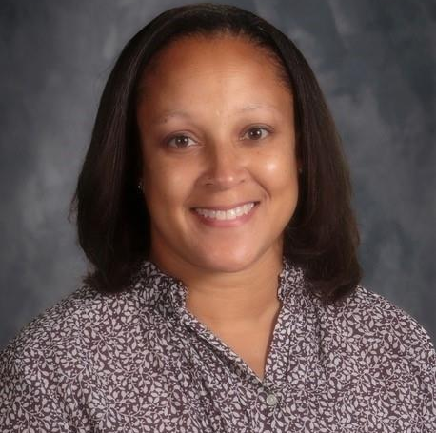
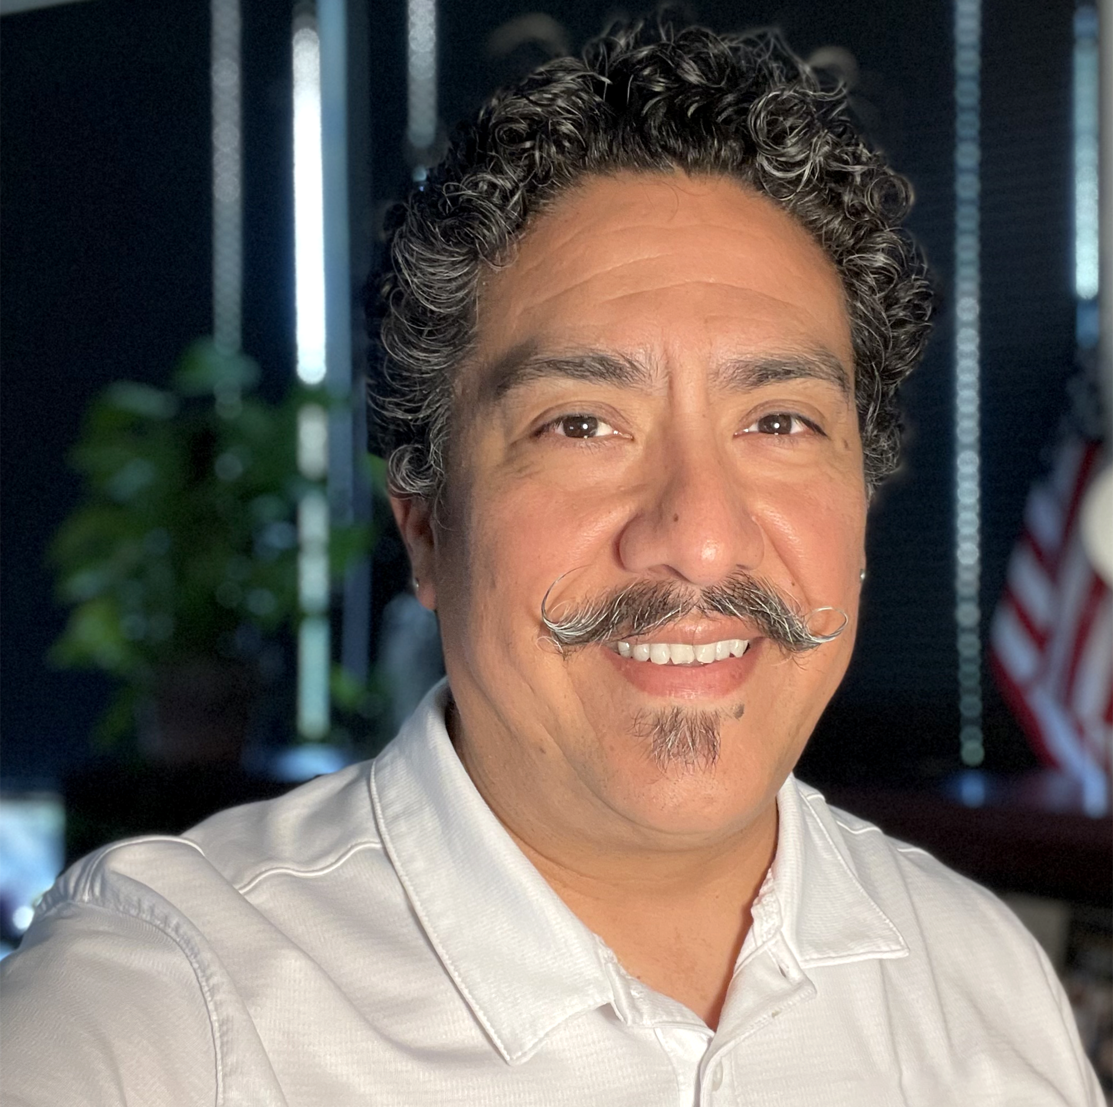

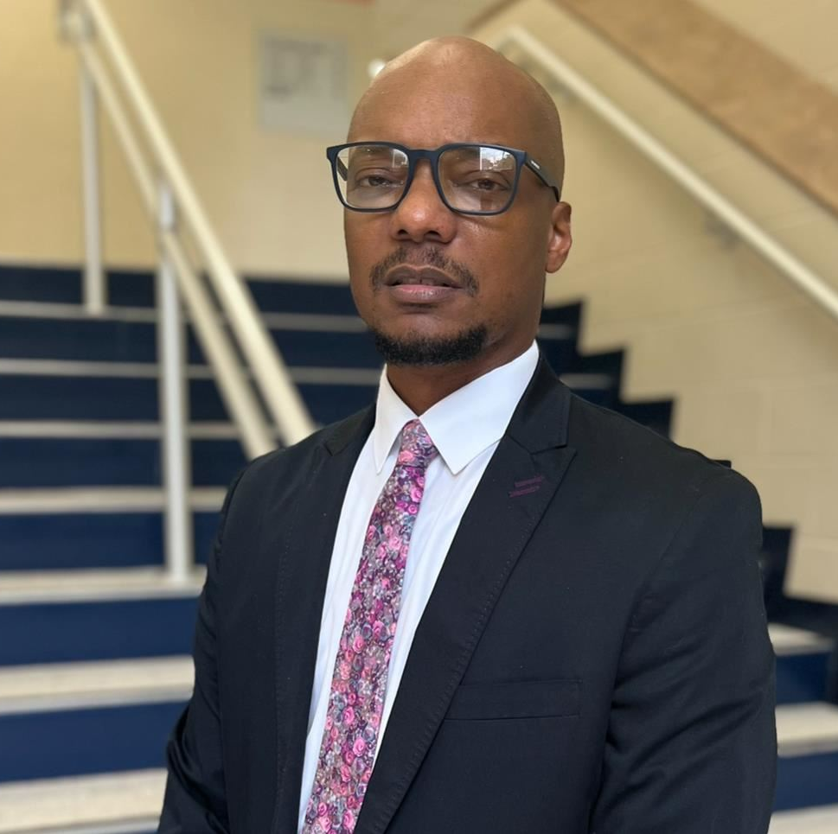
ADMINISTRATION
Dr. Amber Grady
Principal
DeAndria Brigham
Associate Principal
Walter Benavides
Assistant Principal
Dr. Alvin Goldman
Assistant Principal
Brandon Woodard
Assistant Principal

Slide 3
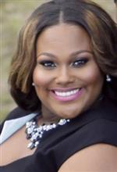
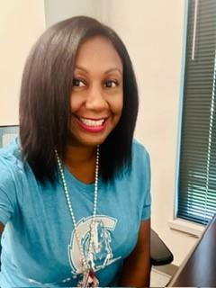
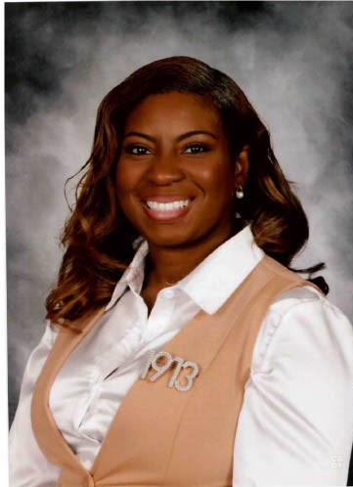
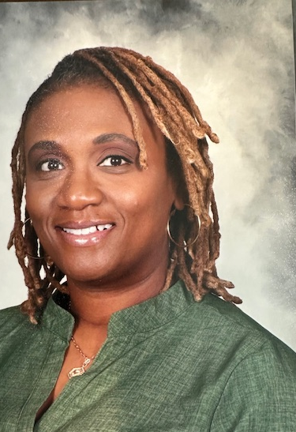
COUNSELORS
ShaQuaella Levy
Lead Counselor
Tanesha Crockett
Counselor
Bionca Johnson
Counselor
Brittaney Norflis
Counselor

Slide 4
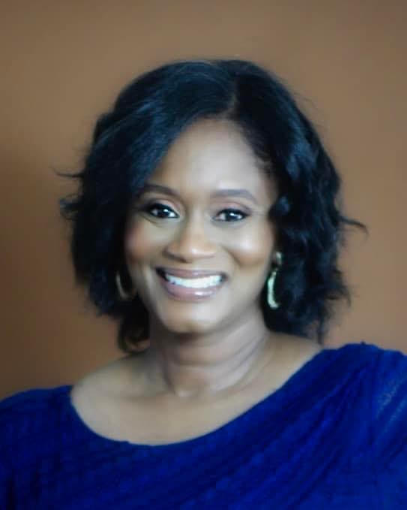
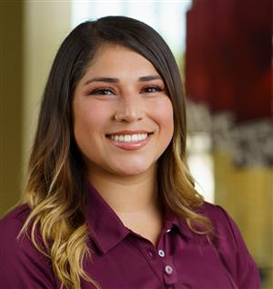
Tanja Dutton
Campus Assessment Coordinator
Dejah Walea
College & Career Readiness Advisor

Slide 5
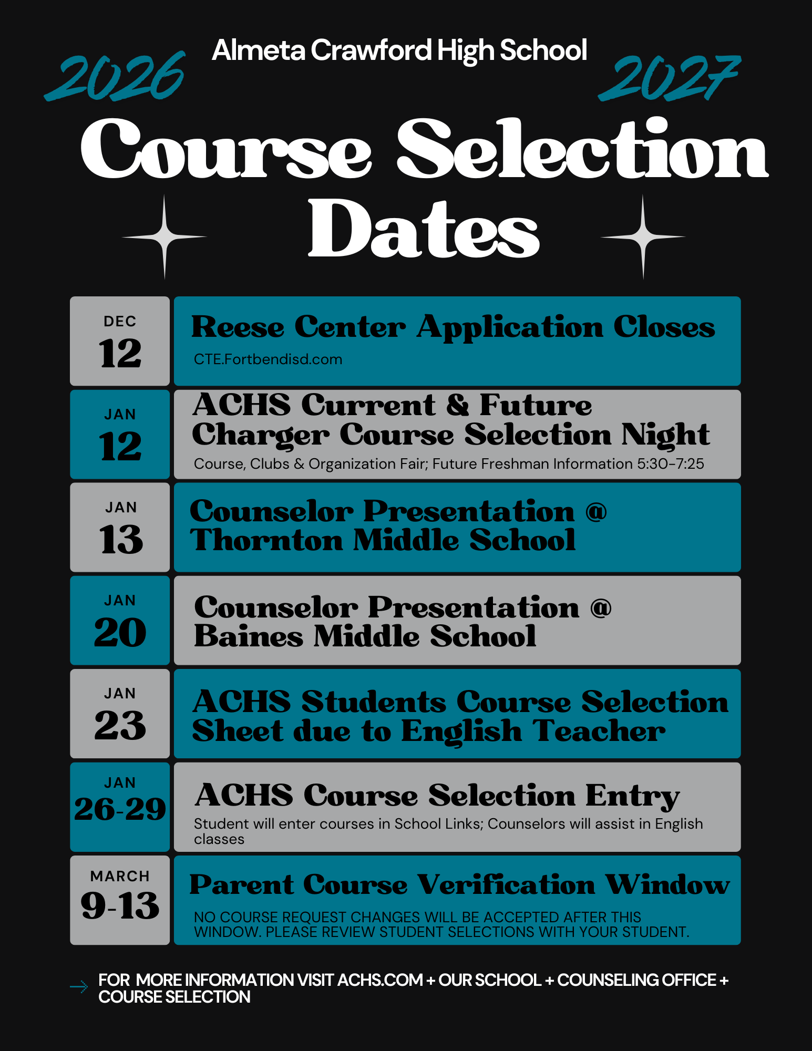
High School Course Selection
SchooLinks course entry opens Monday, January 26th until February 13th
Current ACHS students are completing course request entry January 26-29.
High school counselors will present to 8th grade students January 13 (Thornton) and January 20 (Baines)
Course Verification March 9th - 13th

Slide 6

What you need to graduate with an endorsement:
4 Credits of English
4 Credits of Math
4 Credits of Science
3 Credits of Social Studies (we recommend 4)
2 Credits of World Language
½ Credit of Health
½ Credit of Professional Communications
1 Credit of PE
1 Credit of Fine Arts
4 Endorsement Credits
2 Elective Credits
TOTAL: 26 Credits

Slide 7

Endorsements & Pathways
Endorsement
Pathway
A specified area of interest, similar to a college major, that is required for graduation.
Multidisciplinary Studies
STEM
Business & Industry
Public Service
Arts & Humanities
A particular sequence of courses and credits that lead to an endorsement. You must include a pathway with your endorsement.

Slide 8
The Importance of Pathway Completion
Skill Development and Career Readiness
Career Exploration and Decision-Making
Economic and Workforce Advantages
Building Soft Skills
Boosting Confidence and Independence
Notes:
Skill Development and Career Readiness
Practical Skills: CTE pathways equip students with hands-on, practical skills directly aligned with industry needs.
Certification Opportunities: Many pathways offer certifications or credentials that validate a student's expertise and enhance employability.
Job-Specific Training: Students receive targeted training for specific careers, preparing them to enter the workforce with confidence.
Career Exploration and Decision-Making
Early Exposure: CTE allows students to explore different career options, helping them identify interests and strengths before committing to a career path.
Informed Choices: By completing a pathway, students gain a clearer understanding of the skills and expectations of a profession, leading to more informed career decisions.
Economic and Workforce Advantages
High-Demand Careers: CTE pathways often align with high-demand industries like healthcare, technology, and skilled trades, where skilled workers are needed.
Higher Earnings Potential: CTE graduates with certifications or associate degrees often earn competitive salaries and have opportunities for career advancement.
Building Soft Skills
Teamwork and Communication: CTE programs emphasize collaboration, problem-solving, and effective communication—skills essential for any career.
Professionalism: Students develop work ethics, time management, and responsibility through internships, apprenticeships, and project-based learning.
Boosting Confidence and Independence
Real-World Success: Students who complete a CTE pathway gain confidence in their ability to succeed in both education and their future careers.
Empowerment: By mastering specific skills and achieving certifications, students feel empowered to pursue their goals.
Encouraging students to complete CTE pathways not only enhances their immediate educational experience but also sets the foundation for long-term career success and personal fulfillment. As a counselor, emphasizing these benefits can help students and their families understand the value of these programs.

Slide 9
Grade Level Classifications
Classification | Credits Earned
Freshman – 9th | 0-5
Sophomore – 10th | 6-11
Junior – 11th | 12-17
Senior – 12th | 18 +

Slide 10
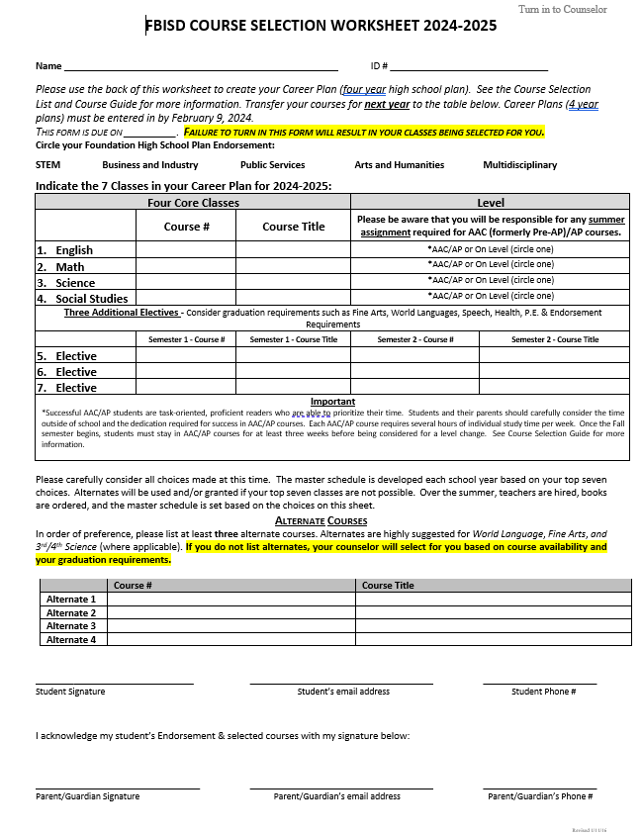
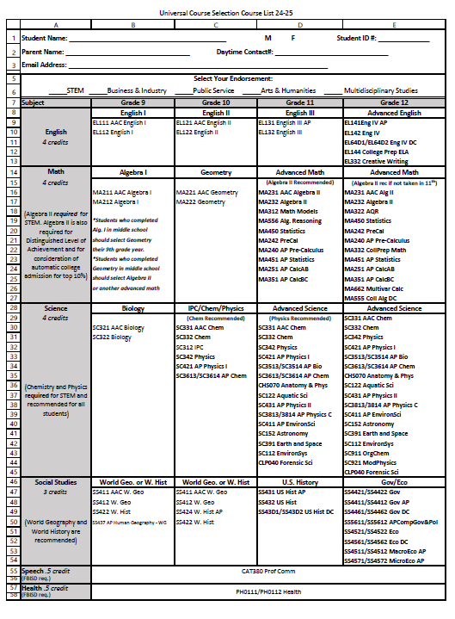

Slide 11
Substitutions
Health | Fine Art | Professional Communication (Speech) | PE
Principles of Health Science (full year) | Floral Design Dance | Debate (full year) | Athletics Dance 1 JROTC Band 1 & 2 (fall only) Kickstart/Off Campus PE (campus and district approval needed)

Slide 12
Important Points to Consider when Building a 4-Year Plan
Want to participate in multiple 4-year programs (ex.: Athletics & AVID)?
You may consider taking a course over the summer.
Are you fluent in a language other than English?
Consider taking a Credit by Exam (CBE).
Are you interested in earning an endorsement through a CTE pathway?
Know the course sequence for your desired pathway.
Take the first course in the pathway sequence during 9th grade.
Want to participate in a certification program at Reese?
Complete PE, Fine Art, Foreign Language, Health & Professional Communication requirements ASAP.

Slide 13

Choosing Alternate Electives
Alternates are critical. Please input a minimum of 3 alternate elective requests. If no alternates are listed, ACHS counselors will select a course on your behalf.
THERE WILL BE NO SCHEDULE CHANGES IN THE FALL. CHOOSE ALTERNATES WISELY!

Slide 14
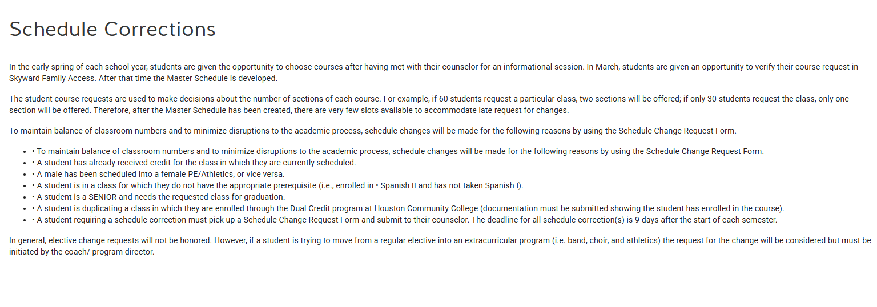
Schedule Corrections

Slide 15
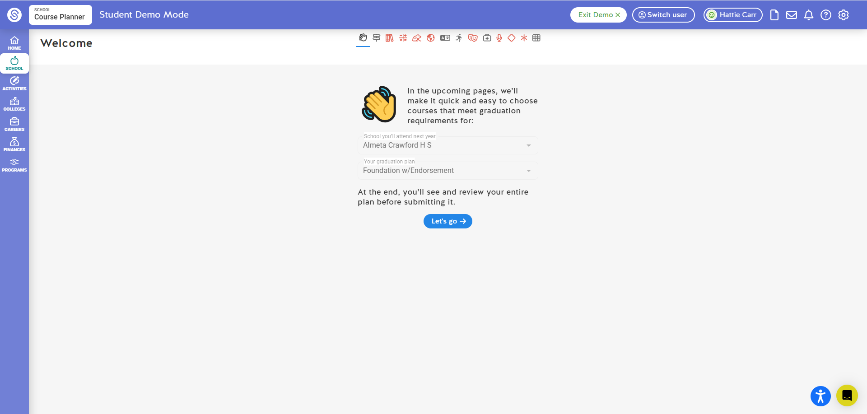
Notes:
ACHS Course input is happening January 27th-31st in Science classes. The middle school Counselors will share more information on course input for their specific campus.
The window for completion ends onf February 14th.

Slide 16
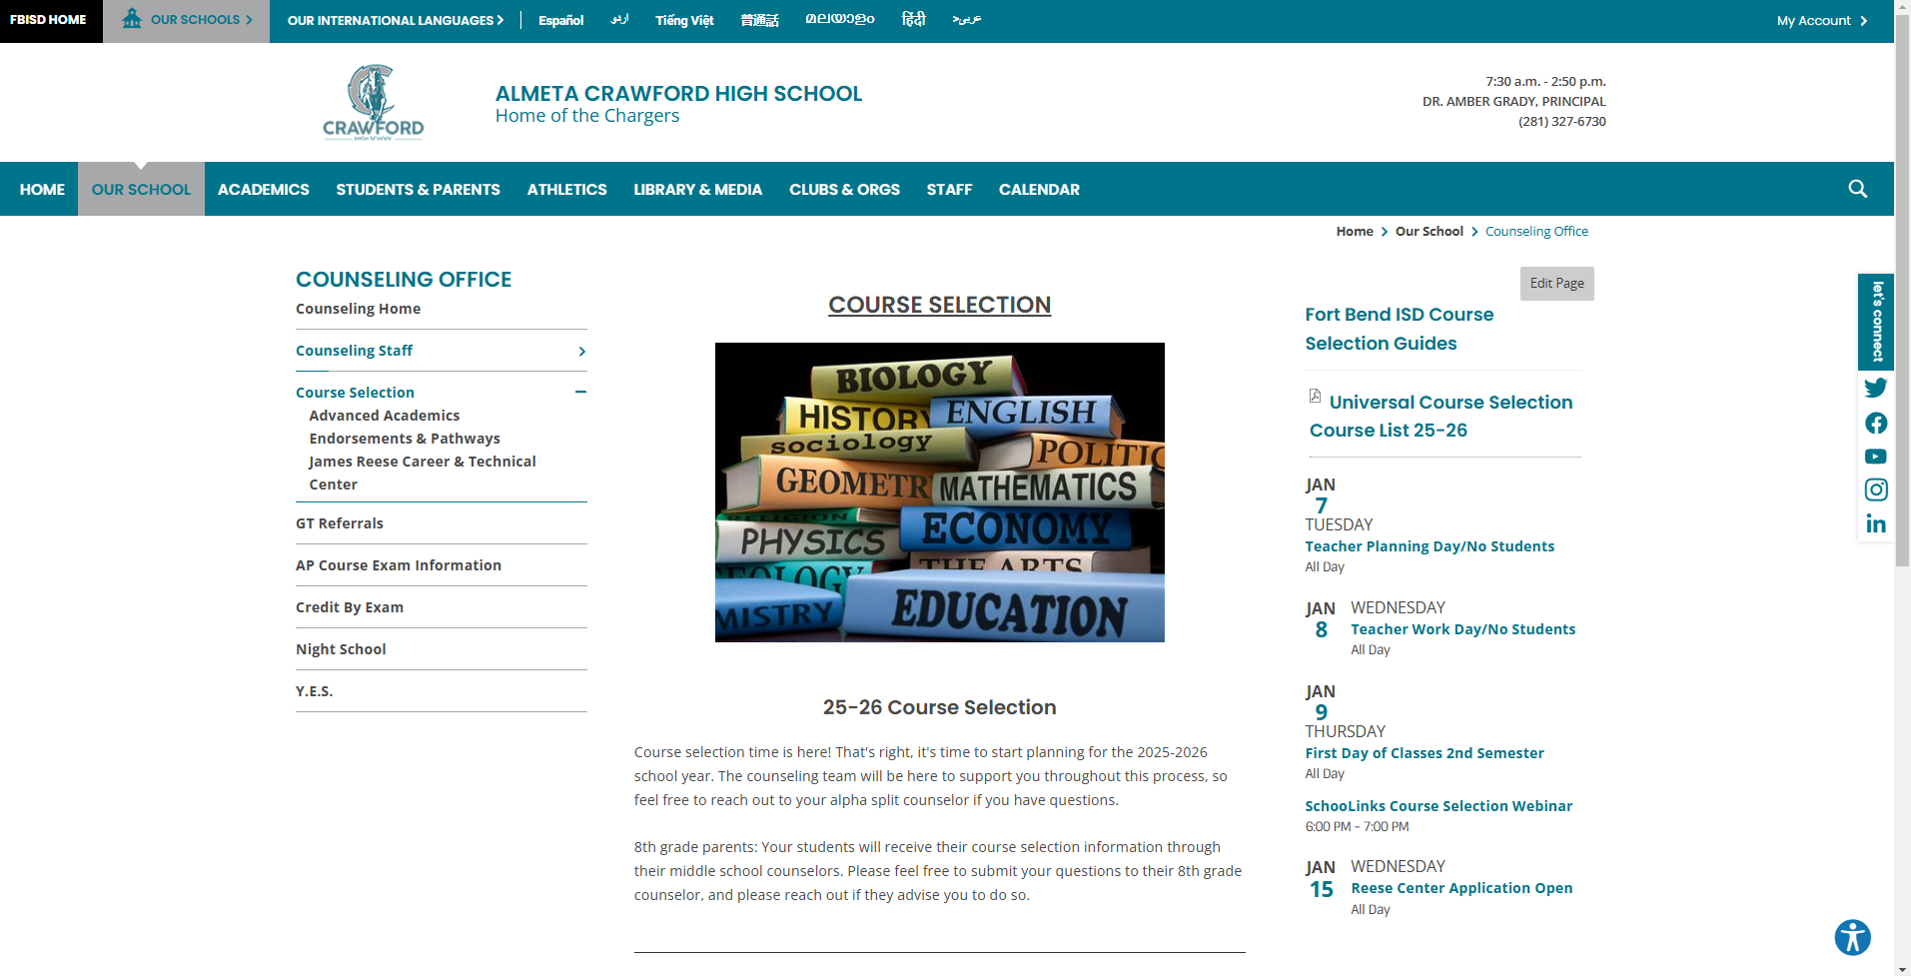

Slide 17
Counselor Contact Information
Email Address
Tanesha.Crockett@fortbendisd.gov
Bionca.Johnson@fortbendisd.gov
Shaquaella.Levy@fortbendisd.gov
Brittaney.Norflis@fortbendisd.gov
Phone Number
281 327 6747
281 327 6805
281 327 6748
281 327 6745

Slide 18
